Slide 1
Plan for Tonight’s Office Hours
Show how the TI-83/84 and TI-Nspire can be used to support teaching and learning in Units 6 and 8 of the AP Statistics Course and Exam Description (CED):
Unit 6: Inference for Categorical Data: Proportions
Unit 8: Inference for Categorical Data: Chi-Square
Along the way, show connections to prior units:
Unit 3: Collecting Data
Unit 5: Sampling Distributions
Share real-world examples that connect concepts in these units.
Answer your questions!

Slide 2
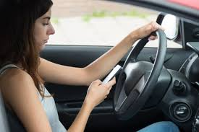
Distracted Driving by Teens
Results from the 2019 National Youth Risk Behavior Survey reveal that 39% of U.S. teen drivers reported texting or emailing while driving in the past 30 days. A South Carolina researcher suspects that the percentage is even higher in his state. He surveys a random sample of 300 S.C. teen drivers; 135 report texting or emailing while driving in the past 30 days.
(a) Do the data provide convincing evidence to support the researcher’s suspicion?
(b) Calculate and interpret a 95% confidence interval for the parameter of interest. Explain how this interval provides more information than the test in part (a).
$$\hat{p}=\frac{135}{300}=0.45>0.39$$
so there is some evidence to support the researcher’s suspicion

Slide 3
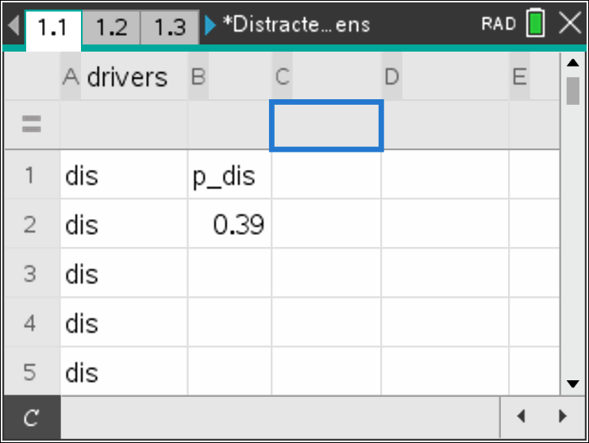
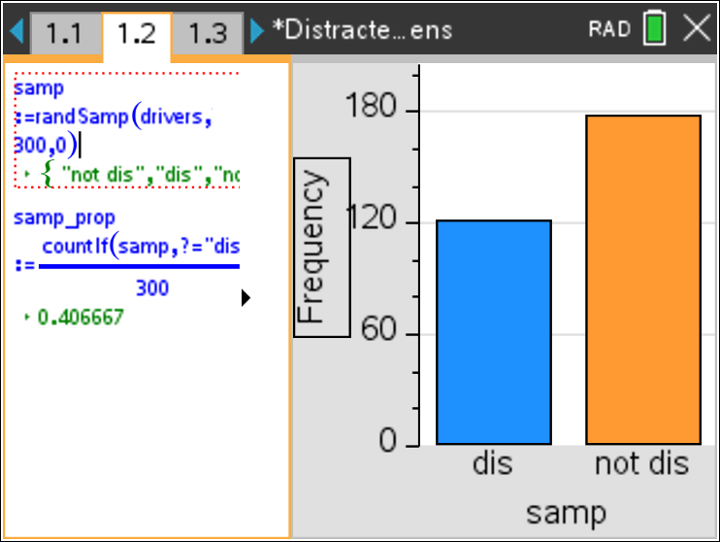
Distracted Driving by Teens
Results from the 2019 National Youth Risk Behavior Survey reveal that 39% of U.S. teen drivers reported texting or emailing while driving in the past 30 days. A South Carolina researcher suspects that the percentage is even higher in his state. He surveys a random sample of 300 S.C. teen drivers; 135 report texting or emailing while driving in the past 30 days.
Do the data provide convincing evidence to support the researcher’s suspicion?
Approach #1: Simulation
$$\hat{p}=\frac{135}{300}=0.45>0.39$$
so there is some evidence to support the researcher’s suspicion

Slide 4
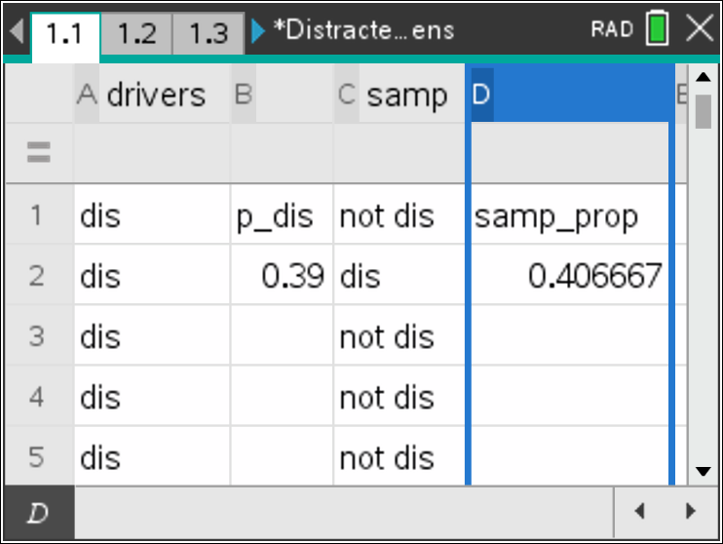
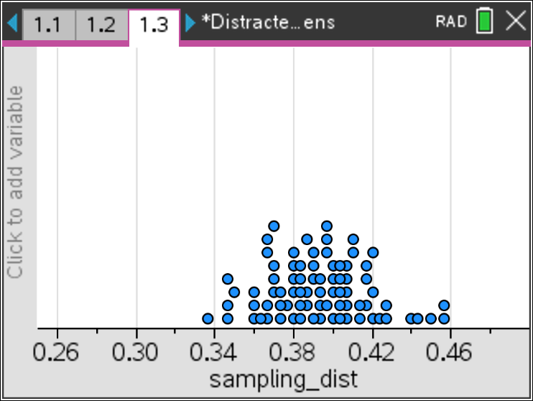
Distracted Driving by Teens
Results from the 2019 National Youth Risk Behavior Survey reveal that 39% of U.S. teen drivers reported texting or emailing while driving in the past 30 days. A South Carolina researcher suspects that the percentage is even higher in his state. He surveys a random sample of 300 S.C. teen drivers; 135 report texting or emailing while driving in the past 30 days.
Do the data provide convincing evidence to support the researcher’s suspicion?
Approach #1: Simulation
$$\hat{p}=\frac{135}{300}=0.45>0.39$$
so there is some evidence to support the researcher’s suspicion

Slide 5
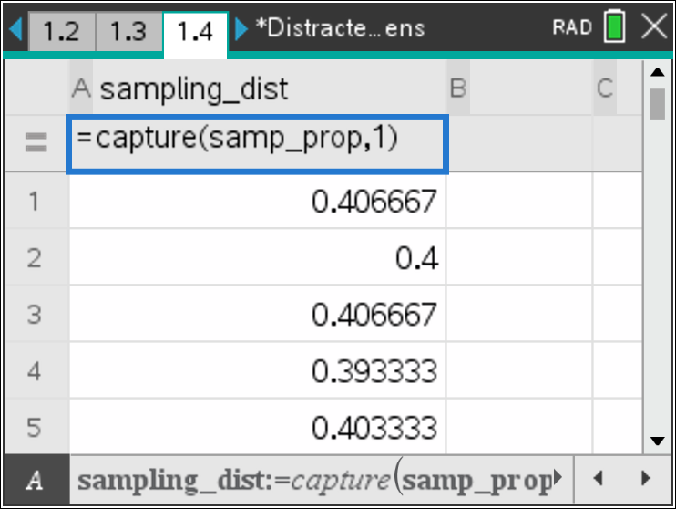
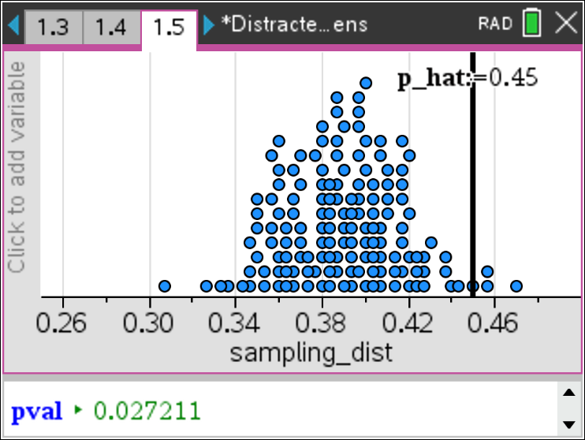
Distracted Driving by Teens
Results from the 2019 National Youth Risk Behavior Survey reveal that 39% of U.S. teen drivers reported texting or emailing while driving in the past 30 days. A South Carolina researcher suspects that the percentage is even higher in his state. He surveys a random sample of 300 S.C. teen drivers; 135 report texting or emailing while driving in the past 30 days.
Do the data provide convincing evidence to support the researcher’s suspicion?
Approach #1: Simulation
$$\hat{p}=\frac{135}{300}=0.45>0.39$$
so there is some evidence to support the researcher’s suspicion

Slide 6
Distracted Driving by Teens
Results from the 2019 National Youth Risk Behavior Survey reveal that 39% of U.S. teen drivers reported texting or emailing while driving in the past 30 days. A South Carolina researcher suspects that the percentage is even higher in his state. He surveys a random sample of 300 S.C. teen drivers; 135 report texting or emailing while driving in the past 30 days.
(a) Do the data provide convincing evidence to support the researcher’s suspicion?
Approach #2: Significance test
$$\hat{p}=\frac{135}{300}=0.45>0.39$$
so there is some evidence to support the researcher’s suspicion
$$H_{0}:p=0.39$$
$$H_{a}:p>0.39$$
where p = the proportion of all S.C. teen drivers who would report texting or emailing while driving in the past 30 days
Use α = 0.05.

Slide 7
Distracted Driving by Teens
Results from the 2019 National Youth Risk Behavior Survey reveal that 39% of U.S. teen drivers reported texting or emailing while driving in the past 30 days. A South Carolina researcher suspects that the percentage is even higher in his state. He surveys a random sample of 300 S.C. teen drivers; 135 report texting or emailing while driving in the past 30 days.
(a) Do the data provide convincing evidence to support the researcher’s suspicion?
Approach #2: Significance test
One-sample z test for a proportion
Random? Random sample of 300 S.C. teen drivers.
10%? There are more than 10(300) = 3000 S.C. teen drivers
Large counts? $np_{0}=3000\left(0.39\right)=1170$ ≥ 10 and
$n{(1−p}_{0})=3000\left(0.61\right)=1830$ ≥ 10.

Slide 8
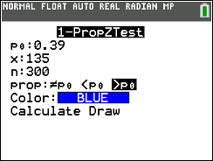
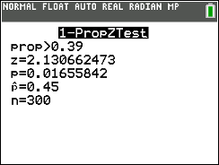
Distracted Driving by Teens
Results from the 2019 National Youth Risk Behavior Survey reveal that 39% of U.S. teen drivers reported texting or emailing while driving in the past 30 days. A South Carolina researcher suspects that the percentage is even higher in his state. He surveys a random sample of 300 S.C. teen drivers; 135 report texting or emailing while driving in the past 30 days.
(a) Do the data provide convincing evidence to support the researcher’s suspicion?
Approach #2: Significance test
$$\hat{p}=\frac{135}{300}=0.45$$
$$z=\frac{0.45−0.39}{\sqrt{\frac{0.39(0.61)}{300}}}=2.13$$
P-value = 0.0166

Slide 9
Distracted Driving by Teens
Results from the 2019 National Youth Risk Behavior Survey reveal that 39% of U.S. teen drivers reported texting or emailing while driving in the past 30 days. A South Carolina researcher suspects that the percentage is even higher in his state. He surveys a random sample of 300 S.C. teen drivers; 135 report texting or emailing while driving in the past 30 days.
(a) Do the data provide convincing evidence to support the researcher’s suspicion?
Approach #2: Significance test
Because the P-value of 0.0166 < α = 0.05, we reject H₀. The data provide convincing evidence that the proportion of S.C. teen drivers who would report texting or emailing while driving in the past 30 days is greater than 39%.

Slide 10
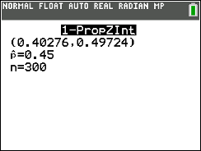
Distracted Driving by Teens
Results from the 2019 National Youth Risk Behavior Survey reveal that 39% of U.S. teen drivers reported texting or emailing while driving in the past 30 days. A South Carolina researcher suspects that the percentage is even higher in his state. He surveys a random sample of 300 S.C. teen drivers; 135 report texting or emailing while driving in the past 30 days.
(b) Calculate and interpret a 90% confidence interval for the parameter of interest. Explain how this interval provides more information than the test in part (a).
We are 90% confident that between 40.276% and 49.724% of all S.C. teen drivers would report texting or emailing while driving in the past 30 days.
This interval does not include 39% as a plausible value for p. It gives the set of all plausible values for p based on the sample data.

Slide 11
Distracted Driving Experiment
Which is more distracting: talking on a cell phone while driving or talking to a passenger? David Strayer and his colleagues at the University of Utah designed an experiment to help answer this question. They used 48 undergraduate students as subjects. The researchers randomly assigned half of the subjects to drive in a simulator while talking on a cell phone, and the other half to drive in the simulator while talking to a passenger. One response variable was whether the driver stopped at a rest area specified by researchers before the simulation started. The table below summarizes the data.
 |  | Distraction
 |  | Cell phone | Passenger
Stopped at rest area? | Yes | 12 | 21
 | No | 12 | 3

Slide 12
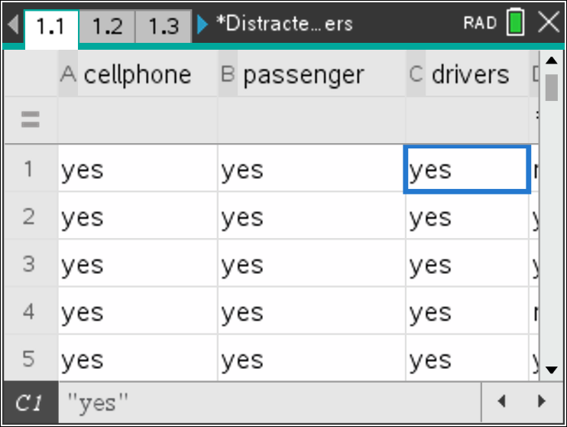
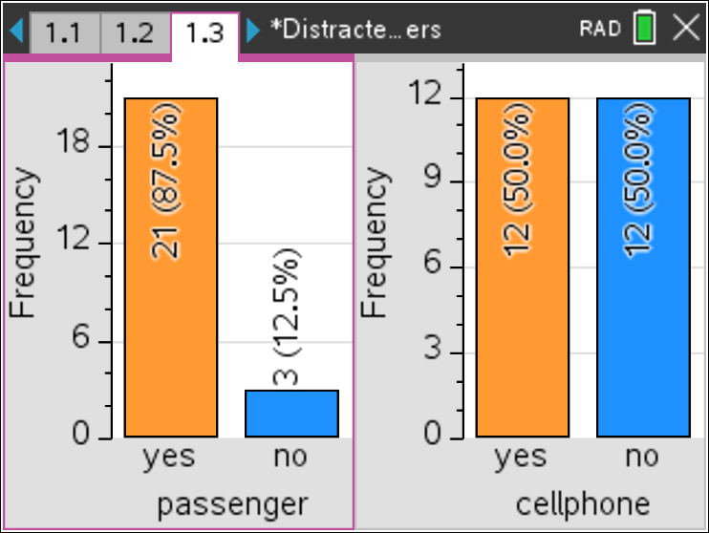
Distracted Driving Experiment
Which is more distracting: talking on a cell phone while driving or talking to a passenger?
Approach #1: Simulation
$${\hat{p}}_{passenger}=\frac{21}{24}=0.875$$
$${\hat{p}}_{cell}=\frac{12}{24}=0.5$$
There is some evidence that talking on a cell phone while driving is more distracting than talking to a passenger
 |  | Distraction
 |  | Cell phone | Passenger
Stopped at rest area? | Yes | 12 | 21
 | No | 12 | 3

Slide 13
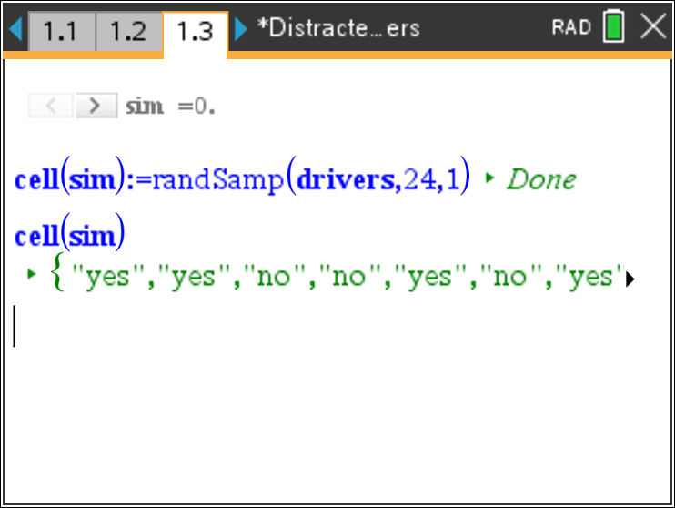
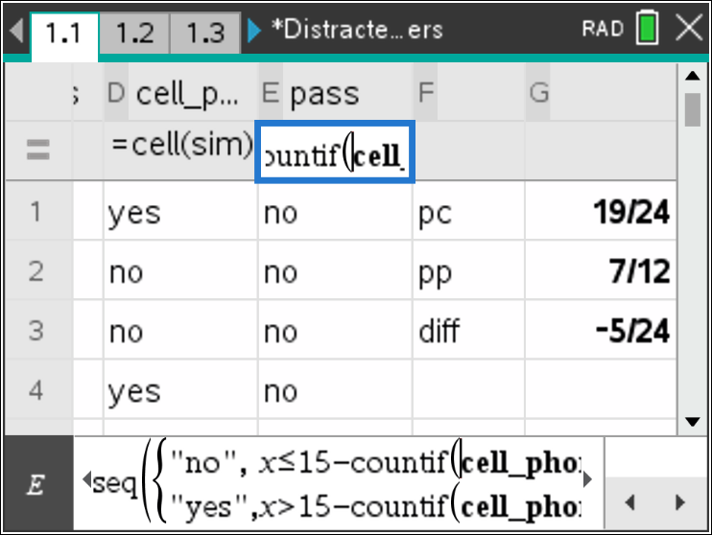
Distracted Driving Experiment
Which is more distracting: talking on a cell phone while driving or talking to a passenger?
Approach #1: Simulation
$${\hat{p}}_{passenger}=\frac{21}{24}=0.875$$
$${\hat{p}}_{cell}=\frac{12}{24}=0.5$$
There is some evidence that talking on a cell phone while driving is more distracting than talking to a passenger
 |  | Distraction
 |  | Cell phone | Passenger
Stopped at rest area? | Yes | 12 | 21
 | No | 12 | 3

Slide 14
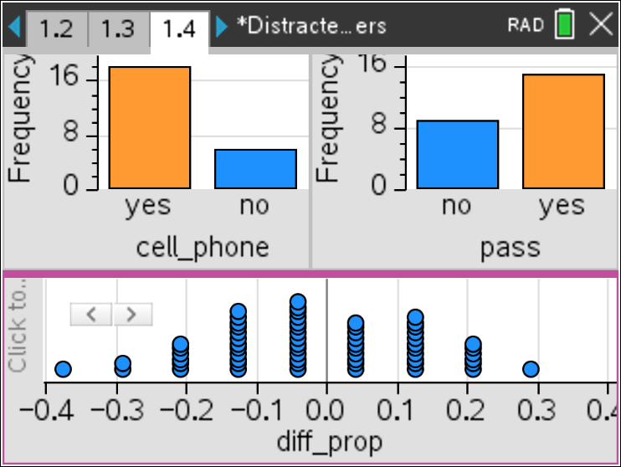
Distracted Driving Experiment
Which is more distracting: talking on a cell phone while driving or talking to a passenger?
Approach #1: Simulation
$${\hat{p}}_{passenger}=\frac{21}{24}=0.875$$
$${\hat{p}}_{cell}=\frac{12}{24}=0.5$$
There is some evidence that talking on a cell phone while driving is more distracting than talking to a passenger
 |  | Distraction
 |  | Cell phone | Passenger
Stopped at rest area? | Yes | 12 | 21
 | No | 12 | 3

Slide 15
Distracted Driving Experiment
Which is more distracting: talking on a cell phone while driving or talking to a passenger?
Approach #2: Significance test
$${\hat{p}}_{passenger}=\frac{21}{24}=0.875$$
$${\hat{p}}_{cell}=\frac{12}{24}=0.5$$
There is some evidence that talking on a cell phone while driving is more distracting than talking to a passenger
 |  | Distraction
 |  | Cell phone | Passenger
Stopped at rest area? | Yes | 12 | 21
 | No | 12 | 3
$$H_{0}:p_{passenger}−p_{cell}=0$$
$$H_{a}:p_{passenger}−p_{cell}≠0$$
where $p_{passenger}$ = true proportion of drivers like these who would stop at the rest area when talking to a passenger and $p_{cell}$ = true proportion of drivers like these who would stop at the rest area when talking on a cell phone.
Use α = 0.05.

Slide 16
Distracted Driving Experiment
Which is more distracting: talking on a cell phone while driving or talking to a passenger?
Approach #2: Significance test
 |  | Distraction
 |  | Cell phone | Passenger
Stopped at rest area? | Yes | 12 | 21
 | No | 12 | 3
$${\hat{p}}_{passenger}=\frac{21}{24}=0.875$$
$${\hat{p}}_{cell}=\frac{12}{24}=0.5$$
$${\hat{p}}_{C}=\frac{33}{48}=0.6875$$
Two-sample z test for a difference in proportions?
Random? Researchers randomly assigned subjects to drive in simulator while talking on cell phone or while talking to passenger
Large counts? $n_{passenger}{\hat{p}}_{C}=24\left(0.6875\right)=16.5$ ≥ 10,
$n_{passenger}(1−{\hat{p}}_{C})=24\left(0.3125\right)=7.5$ < 10,
$n_{cell}{\hat{p}}_{C}=24\left(0.6875\right)=16.5$ ≥ 10,
$n_{cell}(1−{\hat{p}}_{C})=24\left(0.3125\right)=7.5$ < 10
Conditions are not met☹

Slide 17
Distracted Driving Experiment
Which is more distracting: talking on a cell phone while driving or talking to a passenger?
Approach #2: Significance test
 |  | Distraction
 |  | Cell phone | Passenger
Stopped at rest area? | Yes | 12 | 21
 | No | 12 | 3
$${\hat{p}}_{passenger}=\frac{21}{24}=0.875$$
$${\hat{p}}_{cell}=\frac{12}{24}=0.5$$
$${\hat{p}}_{C}=\frac{33}{48}=0.6875$$
Chi-square test for homogeneity?
Random? Researchers randomly assigned subjects to drive in simulator while talking on cell phone or while talking to passenger
 |  | Distraction
 |  | Cell phone | Passenger
Stopped at rest area? | Yes | $$\frac{33∙24}{48}=16.5$$ | $$\frac{33∙24}{48}=16.5$$
 | No | $$\frac{15∙24}{48}=7.5$$ | $$\frac{15∙24}{48}=7.5$$
Large counts?
All expected counts are at least 5.

Slide 18
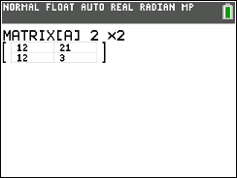
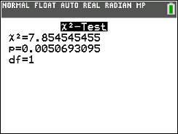
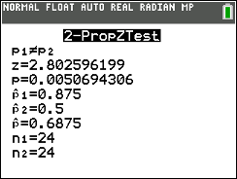
Distracted Driving Experiment
Which is more distracting: talking on a cell phone while driving or talking to a passenger?
Approach #2: Significance test
 |  | Distraction
 |  | Cell phone | Passenger
Stopped at rest area? | Yes | 12 | 21
 | No | 12 | 3
$${\hat{p}}_{passenger}=\frac{21}{24}=0.875$$
$${\hat{p}}_{cell}=\frac{12}{24}=0.5$$
$${\hat{p}}_{C}=\frac{33}{48}=0.6875$$
Conditions are not met☹

Slide 19
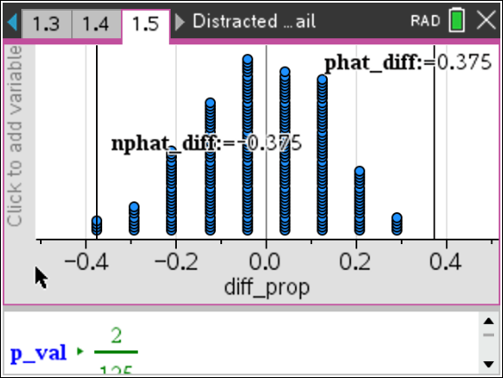
Distracted Driving Experiment
Which is more distracting: talking on a cell phone while driving or talking to a passenger?
Approach #1: Simulation
 |  | Distraction
 |  | Cell phone | Passenger
Stopped at rest area? | Yes | 12 | 21
 | No | 12 | 3
$${\hat{p}}_{passenger}=\frac{21}{24}=0.875$$
$${\hat{p}}_{cell}=\frac{12}{24}=0.5$$
$${\hat{p}}_{C}=\frac{33}{48}=0.6875$$

Slide 20
Distracted Driving Experiment
Which is more distracting: talking on a cell phone while driving or talking to a passenger?
 |  | Distraction
 |  | Cell phone | Passenger
Stopped at rest area? | Yes | 12 | 21
 | No | 12 | 3
$${\hat{p}}_{passenger}=\frac{21}{24}=0.875$$
$${\hat{p}}_{cell}=\frac{12}{24}=0.5$$
$${\hat{p}}_{C}=\frac{33}{48}=0.6875$$
Because the P-value of 0.0057 < α = 0.05, we reject H₀. The data provide convincing evidence that talking on a cell phone while driving is more distracting for people like these than talking to a passenger.

Slide 21
The handout and slides will be posted
<https://education.ti.com/en/bulletinboard/statisticsofficehours>.
Questions?
Enter them in the chat and we’ll get to as many
as we can!

